Slide 1

FONGS is a Hong Kong-based law firm.
Since the day of its opening, FONGS have been providing professional and high quality legal services to local, PRC and international clients.
HK SPIRIT, PRC TIES, INTERNATIONAL VISION
Beijing | Shanghai | Shenzhen | London | Tokyo | Seoul | Paris | Singapore | Cayman

Slide 2
Our Belief
F
O
N
G
S
F
O
N
G
S
FILLING
OFFERING
NEIGHBORING
GROWING
STRIVE
with all sincerity
client-oriented services
different stakeholders
through continuous improvement
for the excellence

Slide 3
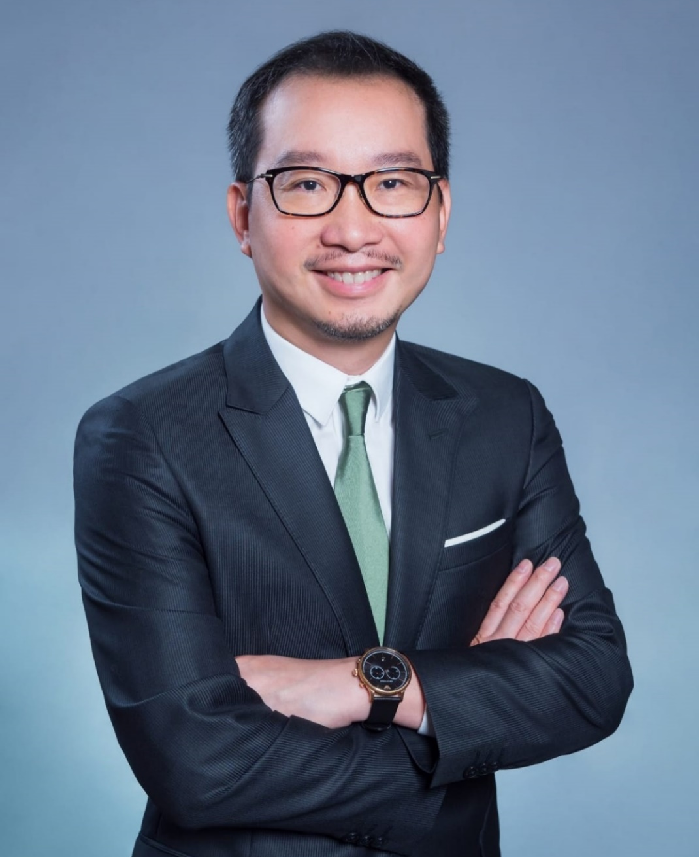
FONGS
Founder and Managing Partner
Dr. Edmond Fong
Honours and Appointments
Political Consultative Conference Si Hui, Guangdong Province (A member of 9th and 10th Committee)
China Elites Association Limited (Founding President)
Hong Kong Securities & Investment Institute (Honourable Speaker)
The Institute of Securities Dealers Limited (Legal Adviser)
Hong Kong Insurance Practitioners General Union (Legal Adviser)
1991 Bachelor of Laws,
The University of Hong Kong
1992 Postgraduate Certificate in Laws,
The University of Hong Kong
1994 Solicitor of
High Court of Hong Kong
2006 Doctor of Jurisprudence,
York University
Qualifications

Slide 4
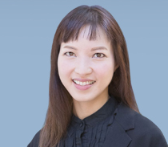
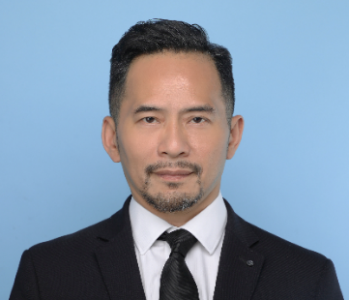
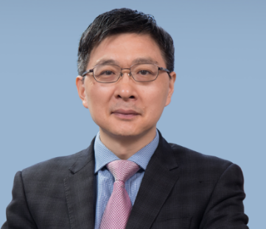
Our Partners
WINNIE
LO
CHRISTOPHER LUK
JACK
ZHANG
PARTNER, HEAD OF
COMPETITION, MEDIA & ENTERTAINMENT
DEPARTMENT
PARTNER,
HEAD OF CHINA
PRACTICE
DEPARTMENT
PARTNER, HEAD OF CONVENCYING
DEPARTMENT
PARTNER

Slide 5
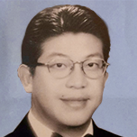
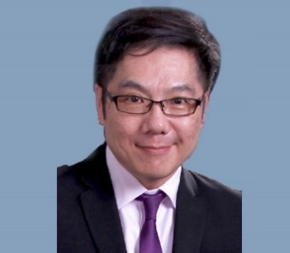
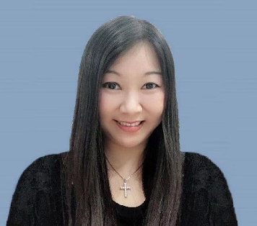
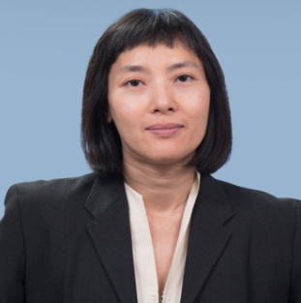
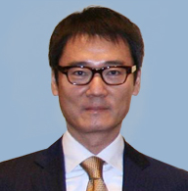
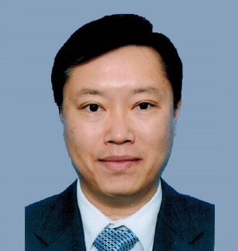
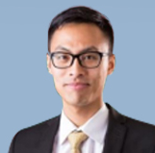
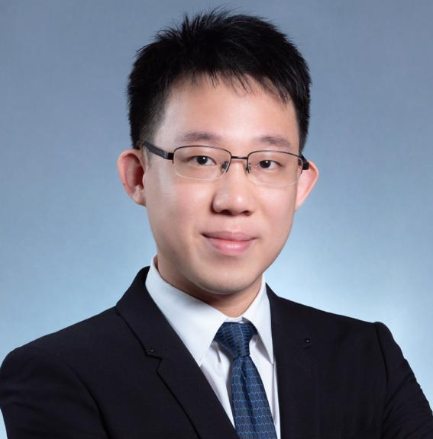
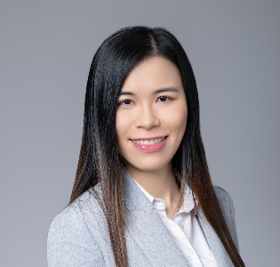
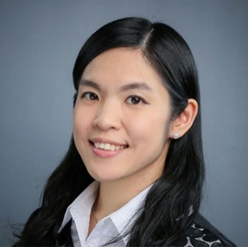
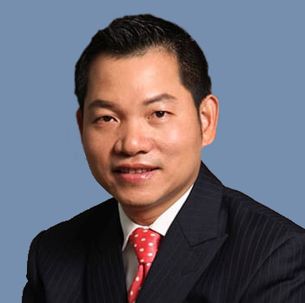
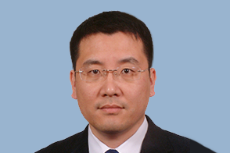
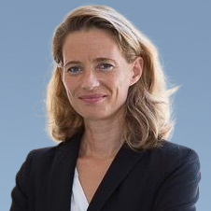
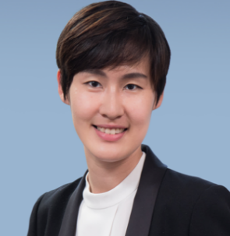
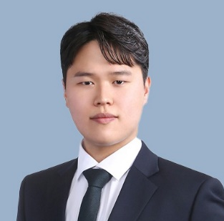
Our Senior Consultants, Consultants,
Registered Foreign Lawyers and Associates
ANDREW
WANG
NEVILLE
CHENG
AVA YIU
MANDY
WONG
SY
CHANG
RAYMOND
CHAN
IVAN LEE
SENIOR CONSULTANT
SENIOR CONSULTANT
SENIOR CONSULTANT
SENIOR CONSULTANT
SENIOR CONSULTANT
SENIOR CONSULTANT
CONSULTANT
Cedric
Leung
VANESSA
LAU
CAROLINE
WONG
ZHENG
CHENG
WU JUN
ADELINE
LE SAINT
NICOLE
CAI
JUSTIN SY
KIM
CONSULTANT
CONSULTANT
CONSULTANT
REGISTERED FOREIGN
LAWYER (PRC)
REGISTERED FOREIGN
LAWYER (PRC)
REGISTERED FOREIGN
LAWYER (FRANCE)
REGISTERED FOREIGN
LAWYER (PRC)
ASSOCIATE
NICOLE
CAI

Slide 6
Our Strength
Active provider of Hong Kong legal and regulatory advice and services in the local capital market.
01
02
03
Our first class legal services to HK, PRC and international clients.
Our lawyers are qualified in Hong Kong, Mainland China and various jurisdictions including France, Korea, Japan, Australia and United Kingdom.
04
Our lawyers speak various languages: English, Cantonese, Mandarin, French, Korean and Japanese.
05
Most lawyers have worked in top tier law firms and have been involved in significant number of high profile cases.

Slide 7

SPENCER-WEST LLP
A leading full-service international law firm based in London, UK.
Established in 2010, 11 offices around the globe, more than 100 solicitors
Value in flexible and collaborative culture, focus on business growth.
Strong international presence & global outlook capabilities.
Full association with FONGS.
Address: Longbow House, 20 Chiswell Street, London EC1Y 4TW
E-mail : info@spencer-west.com
Get a modern PowerPoint Presentation that is beautifully designed.

Slide 8
JOOWON ATTORNEYS AT LAW
(법무법인 주원)
A full-service law firm based in Seoul, Korea
Established in 2009 by Mr. Lee Kun Kae, one of the most experienced and respected lawyers in South Korea.
With focus in ‘one-stop total services’, more than 80 talented lawyers, patent lawyers, CPAs and professional advisers assist clients in the firm’s four branch offices in Korea.
Our associate, Mr Justin Kim, is an adviser of Joowon Attorneys at Law.
Association with FONGS.
Address:(06050) 6F, 711, Eonju-ro, Gangnam-gu, Seoul, Republic of Korea
E-mail : joowon@joowonlaw.com
Get a modern PowerPoint Presentation that is beautifully designed.

Slide 9
ZLF LAW FIRM
(中銀-力圖-方氏 (橫琴) 聯營律師事務所)
Joint Venture of law firms from mainland China, Hong Kong and Macau
The three partners include:
- Zhong Yin Law Firm (Beijing);
- FONGS Lawyers (Hong Kong); and
- Rato, Ling Lei & Cortes (Macau).
Focus on clients in all cross-border matters in China, HK & Macau in all practice areas, including but not limited to, corporate finance, investment, dispute resolution as well as in international intellectual property.
Address：Tower 19, Creative Valley, Hengqin District, Zhuhai, Guangdong, China
Email：info@zlflawoffice.com
Get a modern PowerPoint Presentation that is beautifully designed.

Slide 10
Our Key Practices
01
Securities & Corporate Finance
We have extensive experiences in all aspects of securities law and corporate finance including public offerings, private placements, venture capital financing, mergers and acquisitions, etc.
02
Commercial & Corporate
With our 360-degree approach, we are equipped to act for companies, regardless of their size, and advise them throughout all stages of their corporate life, not only for their transactions, but also in supporting their day-to-day operations.
03
Dispute Resolution
Our team is experienced in all forms of dispute resolution procedures, ranging from litigation to Alternative Dispute Resolutions. We assist and represent our clients in every level of the various courts and tribunals of Hong Kong, as well as on domestic and international arbitrations and mediations.
04
China & International Practice
Our team of solicitors provides to local and international clients, individuals and entities, a wide range of legal services and advises them in their business and investment in the People’s Republic of China and international perspective.

Slide 11
Other Legal Services
Immigration
Project Finance
Option A
Insurance and Employment Law
Life Science and Healthcare
Will, Trust and Probate
Option B
Fintech
Conveyancing and Real Estate
Tax

Slide 12















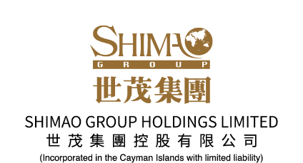












Business Strategic Partners/Clients
12

Slide 13






























Business Strategic Partners/Clients
13

Slide 14

FONGS Forwards
Expanding our professional staff up to 50 in number in next 5 years
Strengthening our commercial, corporate, and capital finance practices
Enhancing cross- border dispute resolutions
Leveraging the Greater Bay Area Policy for PRC market
Strengthening our International Practice
Developing new blooming practices
Enhancing collaborations with stakeholders to achieve win-win goals
Improving our professionalism and services to clients

Slide 15
Thank You
Contact us:
Head Office:
Unit 01-02, 33/F Bank of America Tower
12 Harcourt Road
Central, Hong Kong
Phone: +852 3693 2800
Fax: +852 3693 2801
New Territories Office:
Unit 904, 9/F, HSBC Building Yuen Long
150-160 Castle Peak Road
Yuen Long, New Territories, Hong Kong
Phone: +852 3693 0969
Fax: +852 3693 2801
Email:
info@fongslawyers.com.hk
Website:
www.fongslawyers.com.hk
Beijing | Shanghai | Shenzhen | London | Tokyo | Seoul | Paris | Singapore | Cayman

